Slide 1

Lecture 10: Main Developments of Cloud Computing Case Study 3: Azure

Slide 2
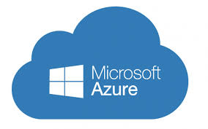
Microsoft Azure
What is Microsoft Azure?
Earlier called “Microsoft Windows Azure”
A cloud computing platform and infrastructure, created by Microsoft, for building, deploying and managing applications and services through a global network of Microsoft-managed datacenters.
It provides SaaS, PaaS, and IaaS services and supports many different programming languages, tools and frameworks, including both Microsoft-specific and third-party software and systems.
Azure was released on February 1, 2010.

Slide 3
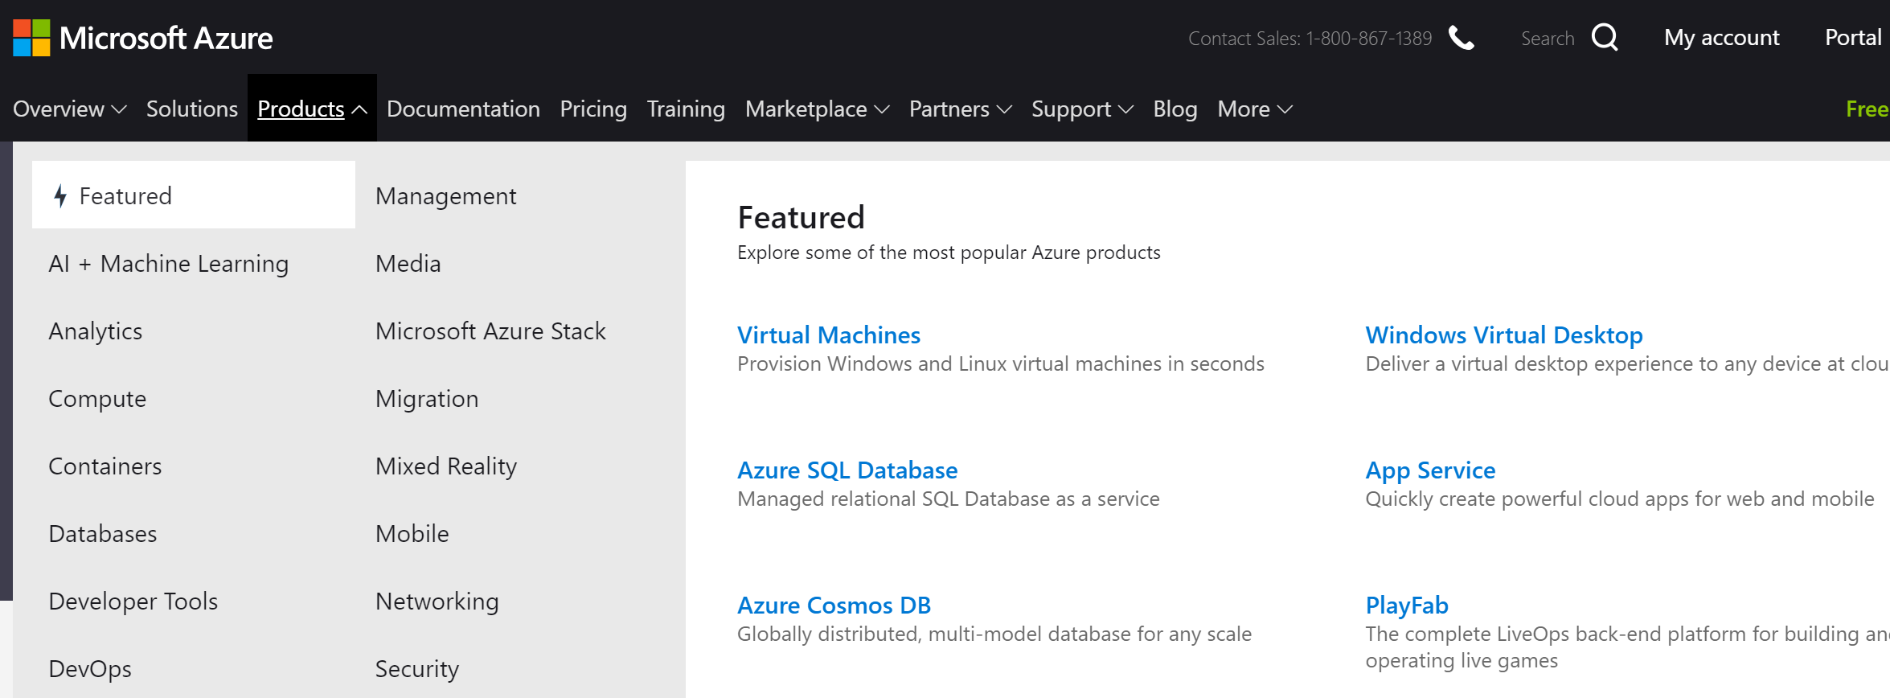
Azure: featured services
Computing services
Virtual machines, …
Data services
Storage
SQL database
CosmosDB (NoSQL)
…
App Services
Network services
Virtual network
Traffic manager
…
https://azure.microsoft.com/en-us/services/

Slide 4
Main Features
Websites allows developers to build sites using ASP.NET, PHP, or Node.js and can be deployed using FTP, Git, Mercurial or Team Foundation Server.
Virtual machines let developers migrate applications and infrastructure without changing existing code, and can run both Windows Server and Linux virtual machines.
Cloud services - Microsoft's Platform as a Service (PaaS) environment that is used to create scalable applications and services. Supports multi-tier scenarios and automated deployments.
Data management - SQL Database, formerly known as SQL Azure Database, works to create, scale and extend applications into the cloud using Microsoft SQL Server technology. Integrates with Active Directory and Microsoft System Center and Hadoop.
Media services - A PaaS offering that can be used for encoding, content protection, streaming, and/or analytics.

Slide 5
Azure Storage
provides scalable, durable cloud storage, backup and recovery solutions for any data, large and small
works with the infrastructure you already have to cost-effectively enhance your existing applications and business continuity strategy
provides storage required by your cloud applications including unstructured text or binary data such as video, audio and images.
The storage types are categorized into the following three types
Block Blobs, Page Blobs and Disks, Tables and Queues

Slide 6
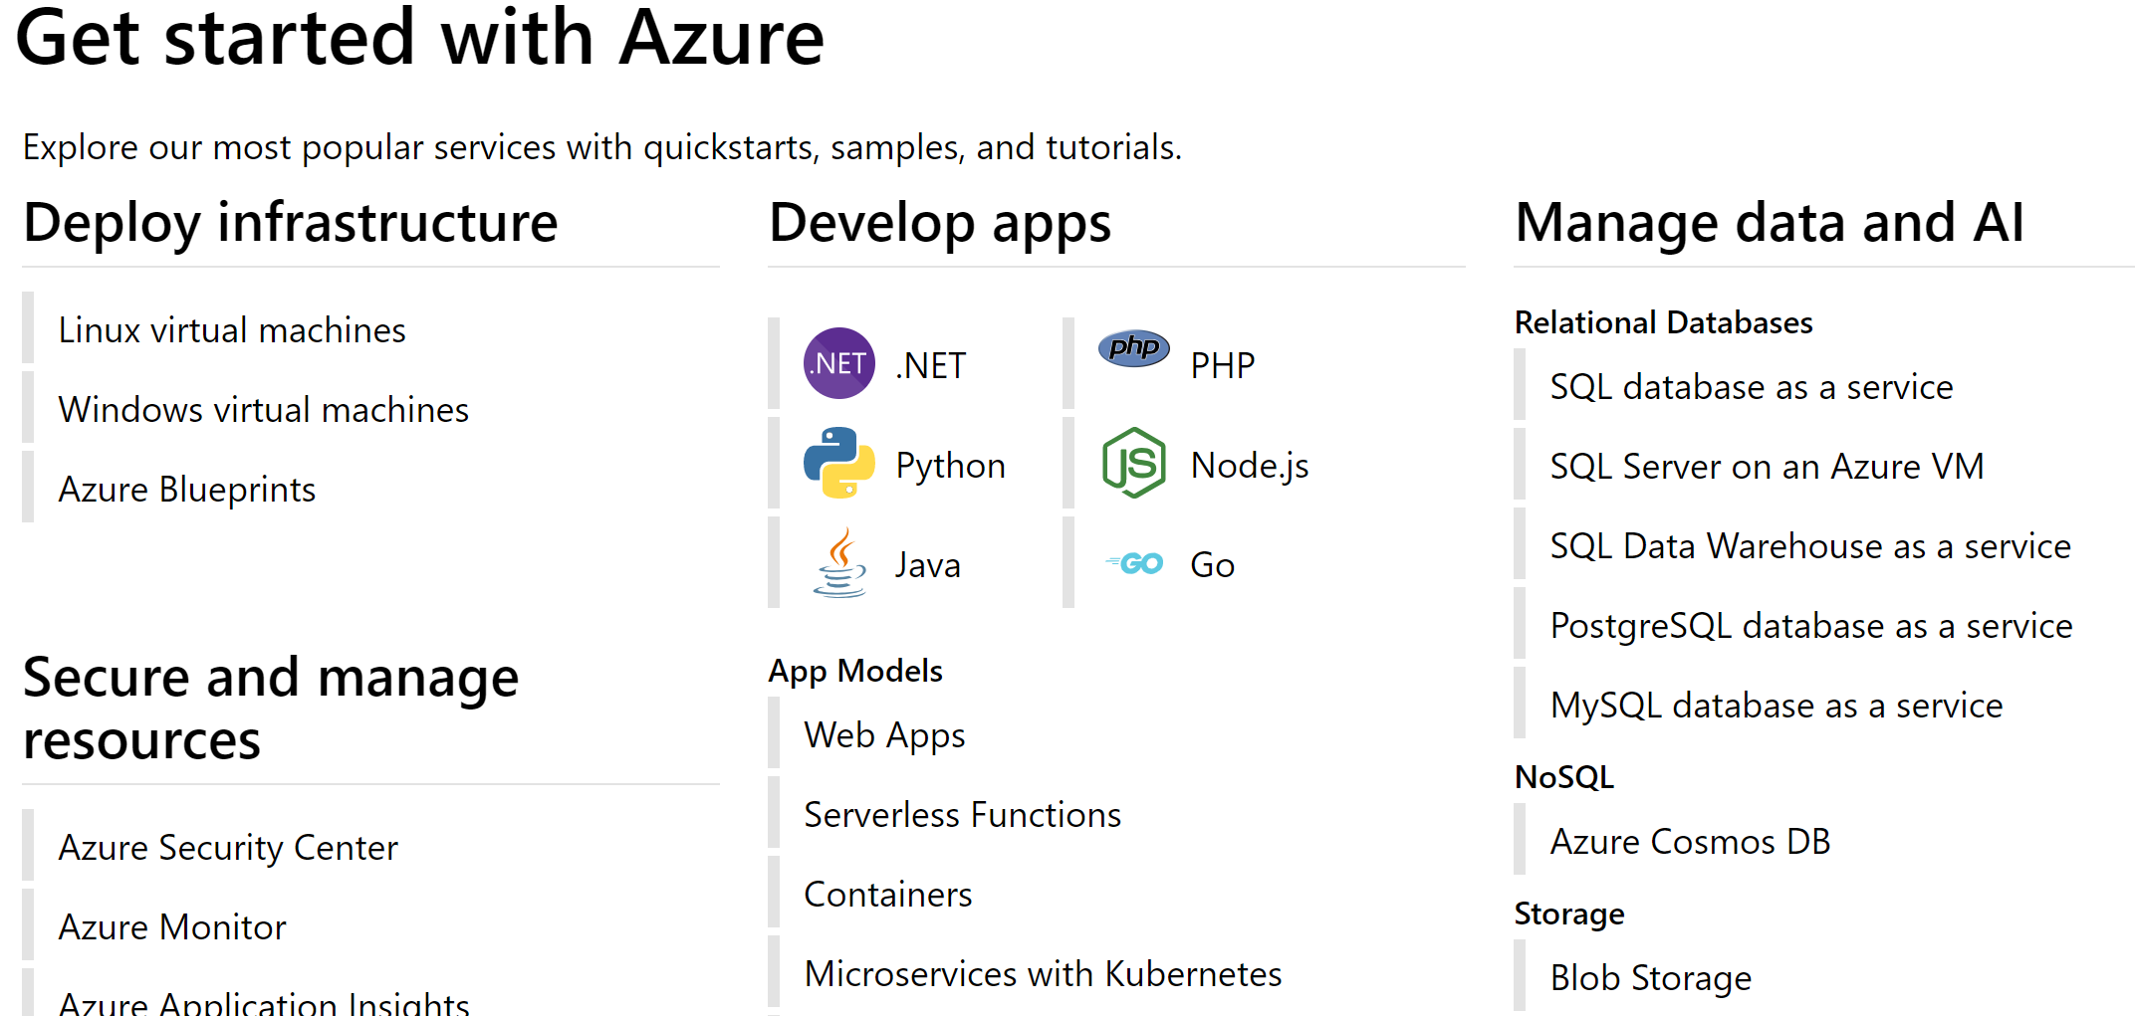

Slide 7
Activity #1
Azure vs. AWS
Microsoft’s claims of Azure over AWS
https://azure.microsoft.com/en-us/overview/?v=48092-1914
Blog comments on key differences of Azure and AWS
https://blogs.msdn.microsoft.com/uk_faculty_connection/2017/03/22/comparing-azure-to-aws-a-quick-guide-to-the-key-differences/
Discussion: do you agree with these evaluation? Why or why not?

Slide 8
Activity #2: Let’s Explore Azure

Slide 9
Summary
Lecture summary: Discussion of selected Microsoft Azure cloud computing services
Unit summary
Introduction to recent developments in cloud computing
Service providers and services
Case studies: Google, Amazon AWS, Microsoft Azure.
Practice
AWS S3
AWS EC2
Feel free to explore other services such as Microsoft Azure etc.
Next Lecture:
MapReduce Programming, Apache Hadoop and Spark

